Slide 1
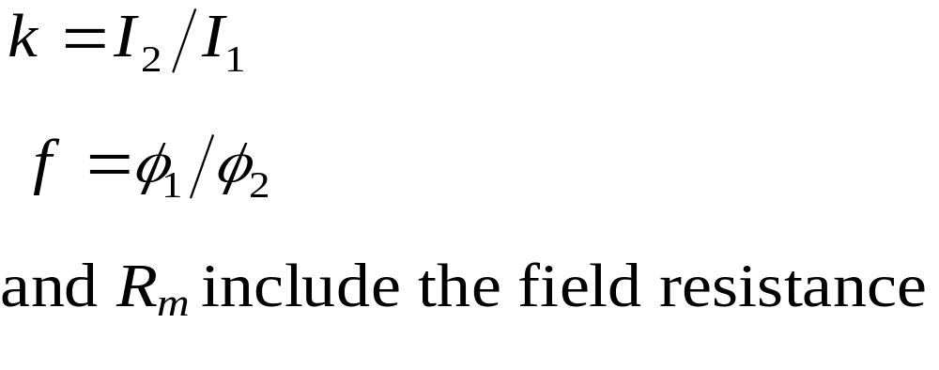


Grading starting resistance for series motor
In the case of the series motor, the flux
changes with the motor current.
Let
The flux produced by I₁ is greater than the flux produced by I₂.

Slide 2
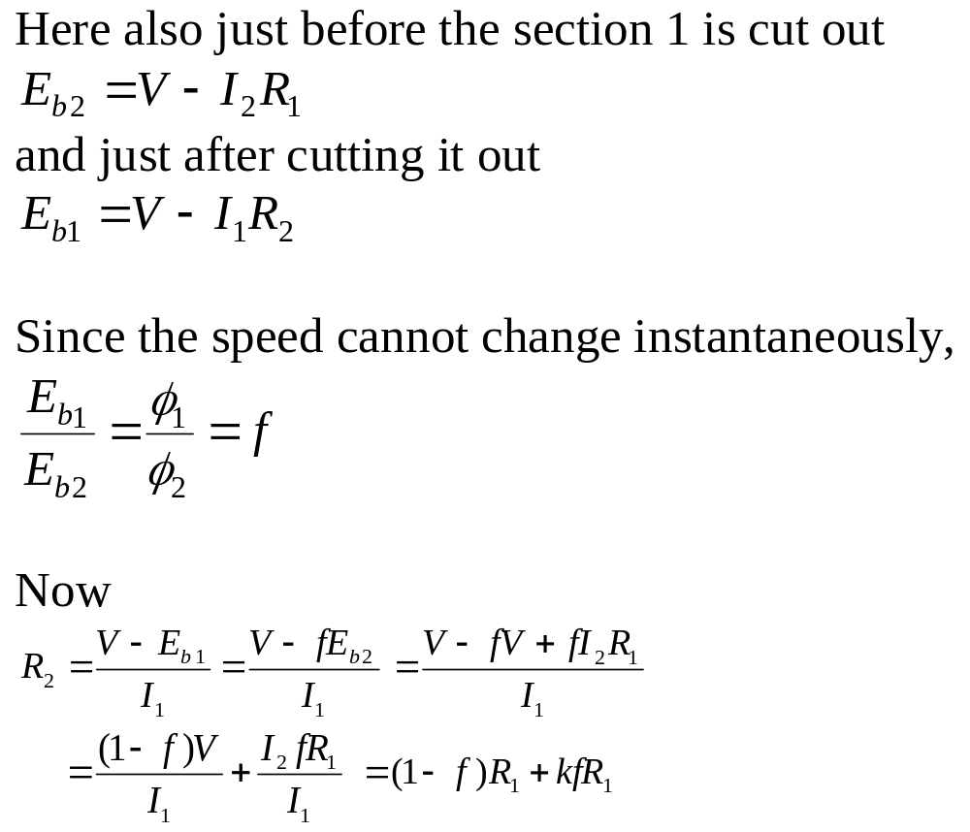

Slide 3
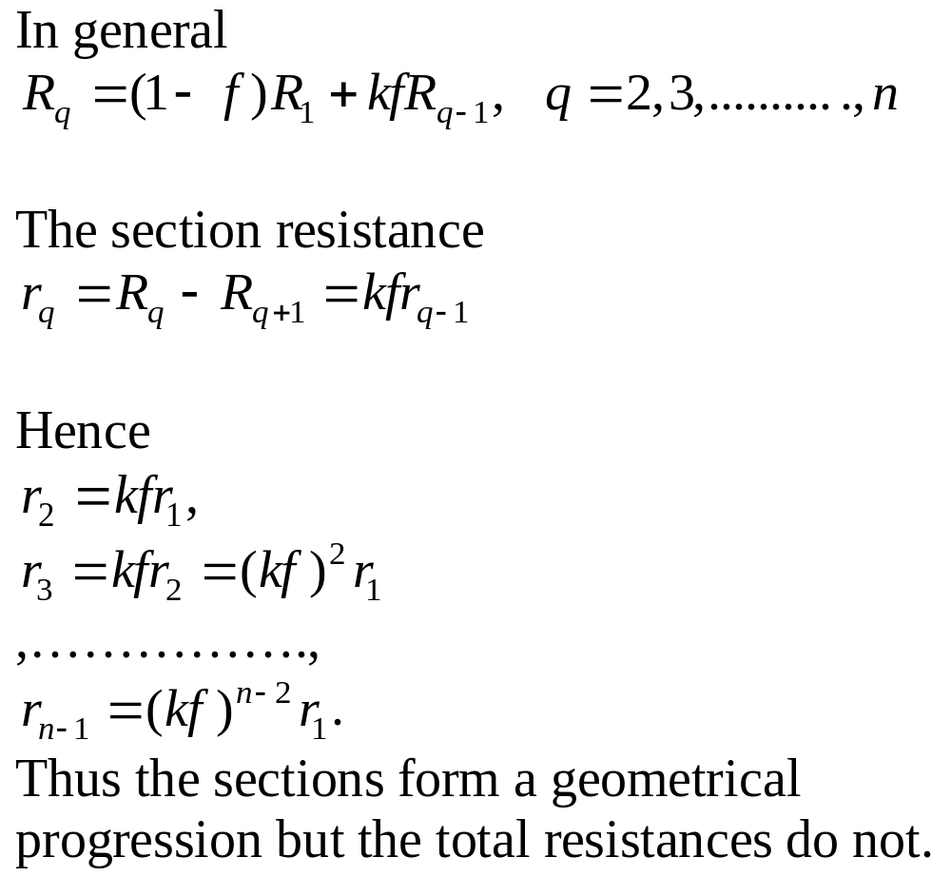

Slide 4
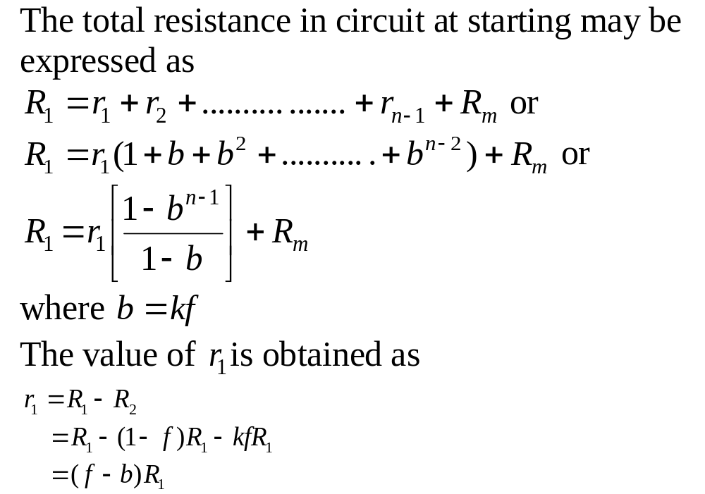

Slide 5
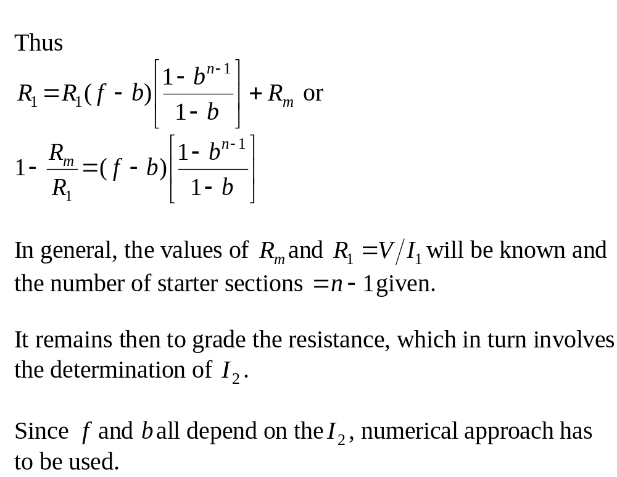

Slide 6
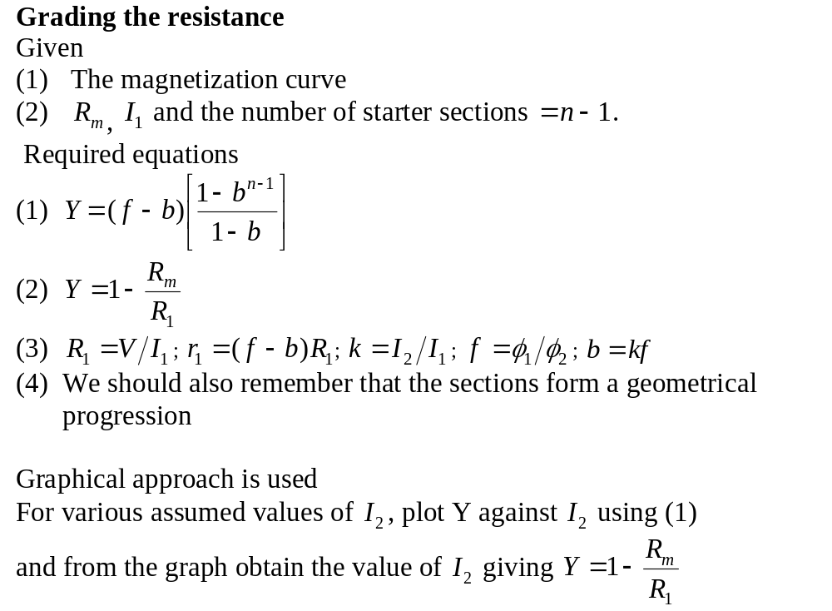

Slide 7
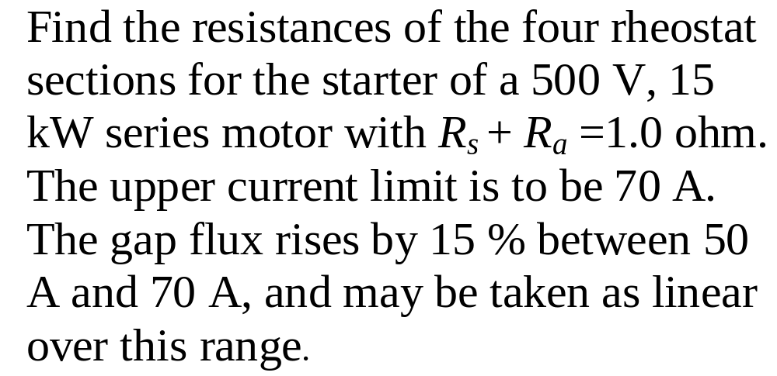

Slide 8
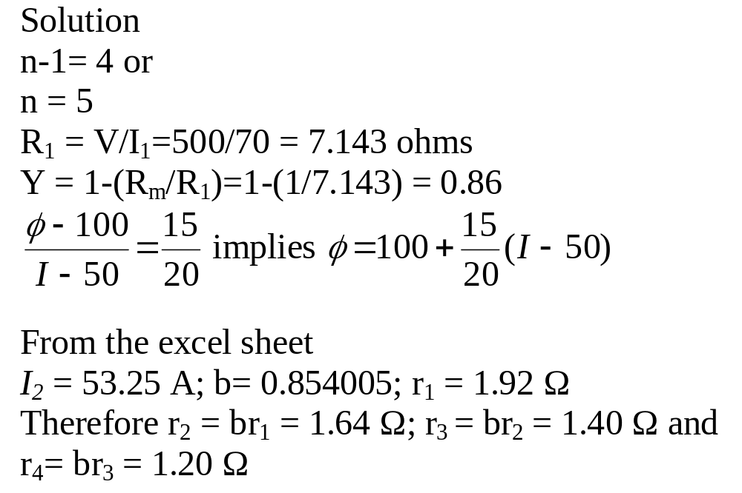

Slide 9
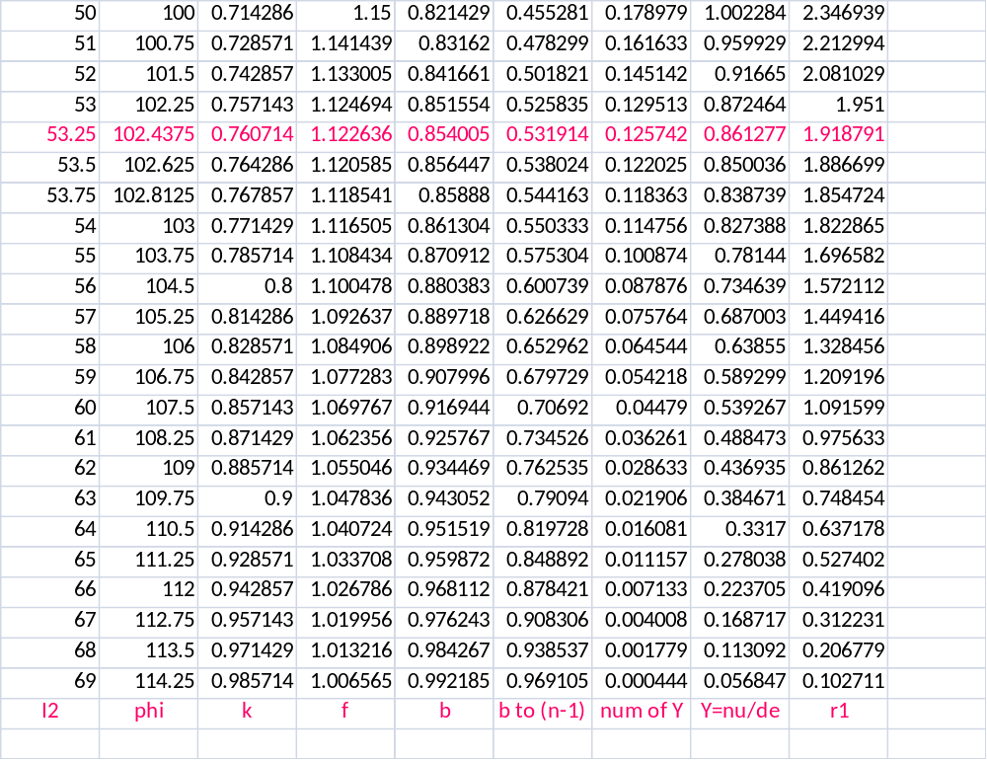

Slide 10
Manual starters
Faceplate starter
Diagram on the next slide shows a faceplate starter for a shunt motor.
Essential Components
The current-limiting resistors R₁, R_{2,} R₃ and R_{4.}
Conducting arm 1 with insulated handle 2 used to cut out the resistors successively.

Slide 11
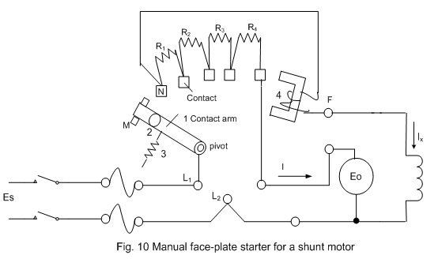

Slide 12
Faceplate starter
Essential components cont’d
Contact M , a dead contact. At this position, the motor circuit is open.
Electromagnet 4 in series with the shunt field which holds the arm at the close position.
Spring 3 which pulls the arm to the dead position when the electromagnet releases it.

Slide 13
Faceplate starter
Safety feature:
If the supply voltage should fail or the field excitation should be lost, the electromagnet releases the arm allowing it to return to its dead position, under the pull of spring 3.
This safety feature prevents the motor from restarting unexpectedly when the supply voltage is re-established and also from being energized when the excitation is lost.

Slide 14
Faceplate starter
The faceplate starter is obsolete except for small motors up to 5 kW.
They are limited electrically because they tend to arc between the sliding surfaces, resulting in rapid wear of the contacting surfaces.
They are also not operator-proof and cannot be used in simple applications such as motor reversal or braking.

Slide 15
Manual starters
Drum controller
This is an improved manual starter.
Stationary contact fingers under spring pressure make contact with a set of contact bars mounted on a cylindrical drum.
The required switching is made by rotating the drum manually.

Slide 16
Drum controller cont’d
The manual effort needed for operation limits the application to motors of about 100 kW.
They are used on crane motors, elevators, machine tools and other applications for start, stop, reverse and speed control.

Slide 17
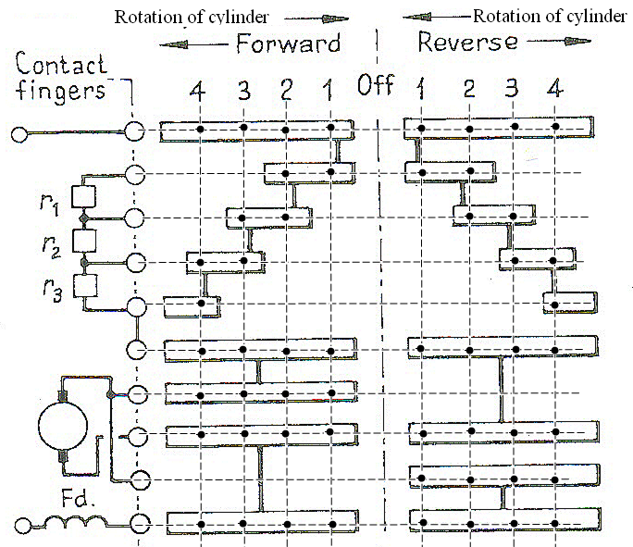

Slide 18
Automatic starters
In modern industrial applications, push-button is used to initiate the starting of most dc motors (both small and large) and
automatically controlled contactors used to effect the subsequent switching.
There are basically three types of automatic starters:
- direct-on-line,
- current-controlled or current-limit and
-definite-time starters.

Slide 19
Direct-on-line starter
This is used to start small dc motors.
These motors draw low starting current so starting resistance is not necessary.
We consider a direct-on-line starter using a dual winding contactor .
Dual contactor has two windings (or coils) known as starting winding and holding winding.

Slide 20
Direct-on-line starter cont’d
During the closing of the contactor a large magnetic pull is required so both windings are energised
In the closing position a small holding force is required so only the holding winding is energised.

Slide 21
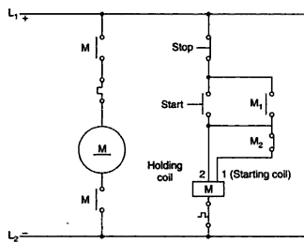
Automatic starters-Direct-on-line starter

Slide 22
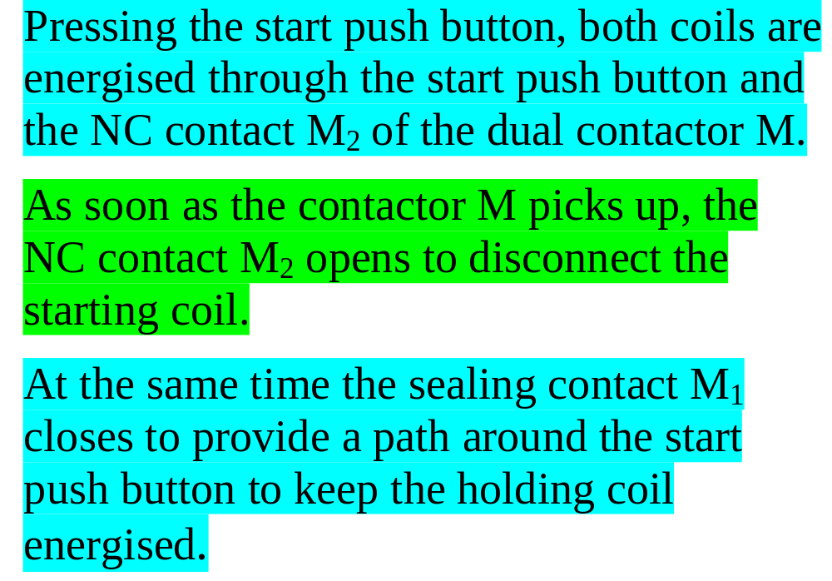

Slide 23
Current limit or current controlled starters
In this type of starter, the starting time depends on the motor load.
A lightly loaded motor is brought to final speed more quickly than a heavily loaded motor.
There are three basic types(the first two are discussed):
series relay, counter emf and lockout type.

Slide 24
Series relay:
In this starter, each resistance step is cut out as soon as the current falls to the lower limit.
The starting time thus depends on the load (This an advantage).
However, on heavy load the sequence is lost if the current fails to drop to its lower limit (This is a disadvantage).

Slide 25
Series relays cont’d
The coils of the series relays used in this starter carry the full armature current.
The relays are fast acting: they picked immediately a high armature current is sensed.
When the current falls below the setting of a relay, a strong spring opens its contact.

Slide 26
Series relays cont’d
To follow how the starter circuit to be discussed works, we need to know
  that the NO auxiliary contacts of the contactors close after some delay from the closing of their main or power contacts and
  that the series relays operate much faster than the contactors.

Slide 27
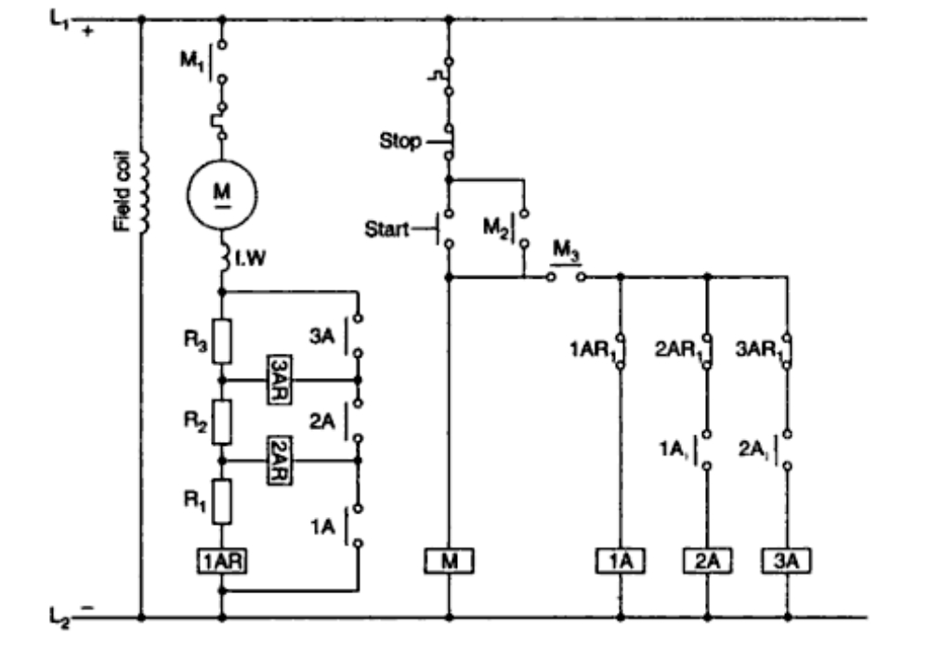

Slide 28
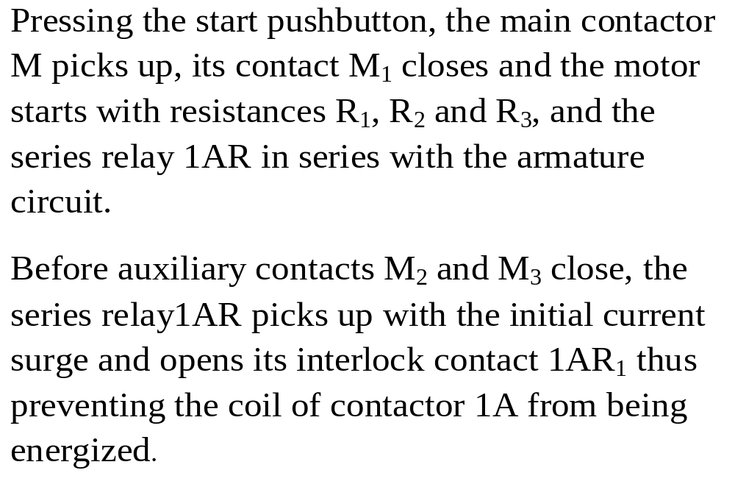

Slide 29
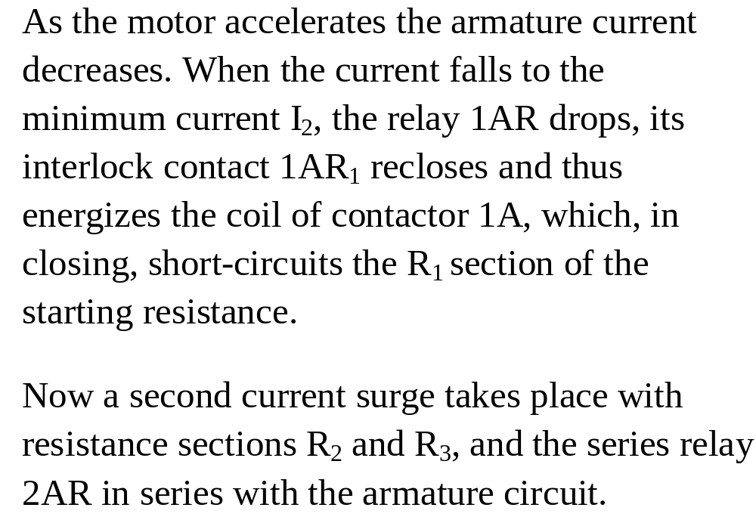

Slide 30
